Slide 1
Becoming a Broker

Slide 2
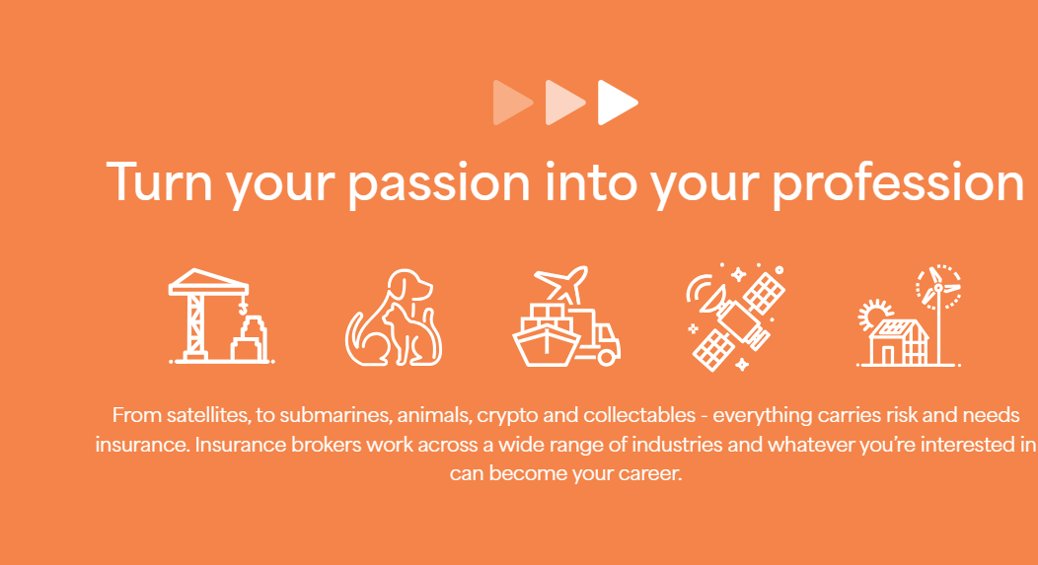
Notes:
Give a brief introduction to the possibilities open to them. If they like art, music, animals or planes, they can follow their passion in Insurance Broking

Slide 3

Lesson Overview
What is insurance?
Types of Insurance
What does an insurance broker do?
Pathways to becoming a broker

Slide 4

What is Insurance?
Insurance is a way for people and businesses to protect themselves against unexpected financial losses.
When you buy insurance, you pay a fee (called a premium) to an insurance company.
Then, if something goes wrong - like an accident, theft, or fire- the insurance company helps cover the costs, so you don’t have to pay everything yourself.
Notes:
Before starting the slide, perhaps prompt the class with a question ‘Do you know what Insurance is’

Slide 5
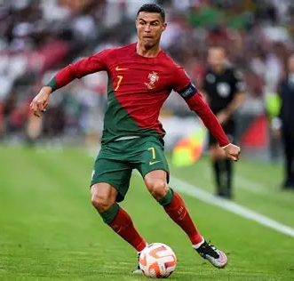
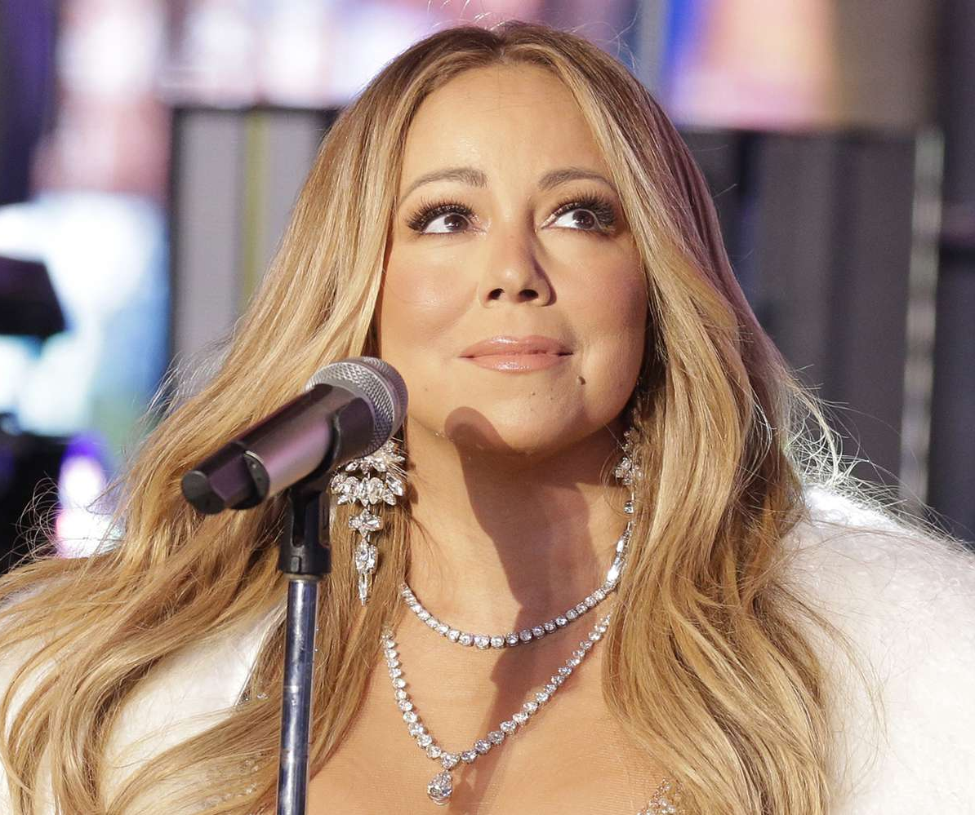
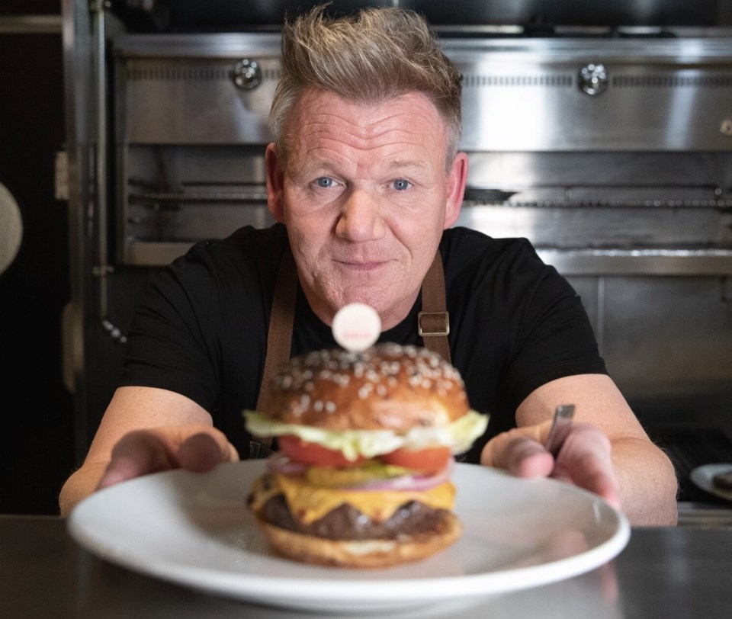
Did You Know…
Cristiano Ronaldo has his legs insured for a reported $145 million USD!
Mariah Carey reportedly insured her voice during one of her tours, with sources citing a figure of around $35 million USD!
Gordon Ramsay reportedly has his taste buds insured for a sum of $10 million USD !

Slide 6
As you can see, there are lots of things that need insurance, and lots of different types of insurance.

Slide 7









Here are some examples of the types of insurance people or businesses may need, but there are many more…..
Public Liability Insurance
Covers you if someone gets hurt or something gets damaged because of your business
Business Property Insurance
Covers your shop, gear, or stock if there’s a fire, theft, or storm damage.
Income Protection
Covers a business owner’s or key worker’s income if they can’t work due to illness or injury
Business Interruption Insurance
Helps cover lost income if your business can’t open after damage or disaster.
Workers’ Compensation
Covers employees if they get hurt or sick while working.
Pet Business Insurance
For groomers, walkers, or vets — covers accidents, injuries, or pet escapes.
Farm Insurance
Protects crops, livestock, and machinery from damage or loss
Cyber Insurance
Protects you if hackers steal data or shut down your system.
Creative or Entertainment Insurance
Covers musicians, artists, or filmmakers if something unexpected happens.
Notes:
Click through one by one to give an overview and explainer – important to understand each of these for the activity later

Slide 8


So, what is an Insurance Broker?
An insurance broker helps people and businesses find the right insurance to protect what’s important to them.
A broker’s job is to make sure their client is properly covered if something goes wrong - like a fire, accident, or theft.
Brokers work for their clients, not for insurance companies. That means they can look at lots of different options and give honest advice about what fits best.
Notes:
Again prompt the class before slide to ask if they know what an insurance broker is or does

Slide 9

Why Insurance Brokers are Important
Insurance brokers are important because they help people and businesses find the right insurance without the stress. If something goes wrong, they guide you through the claims process so you’re not doing it alone.
Real-world impact - helping businesses stay open after disasters, supporting communities after catastrophes, protecting jobs and industries, and contributing to a stronger economy. When major events like bushfires or cyclones hit, brokers are often among the first to help clients navigate what to do next.
In short, brokers save you time and money, reduce confusion, and help keep people, businesses, and communities moving forward.

Slide 10
“What Risks Do They Face?” —Think Like a Broker
Activity
Notes:
These are designed to be a class discussion – show each persona and ask the class to discuss risks and their potential insurance cover

Slide 11
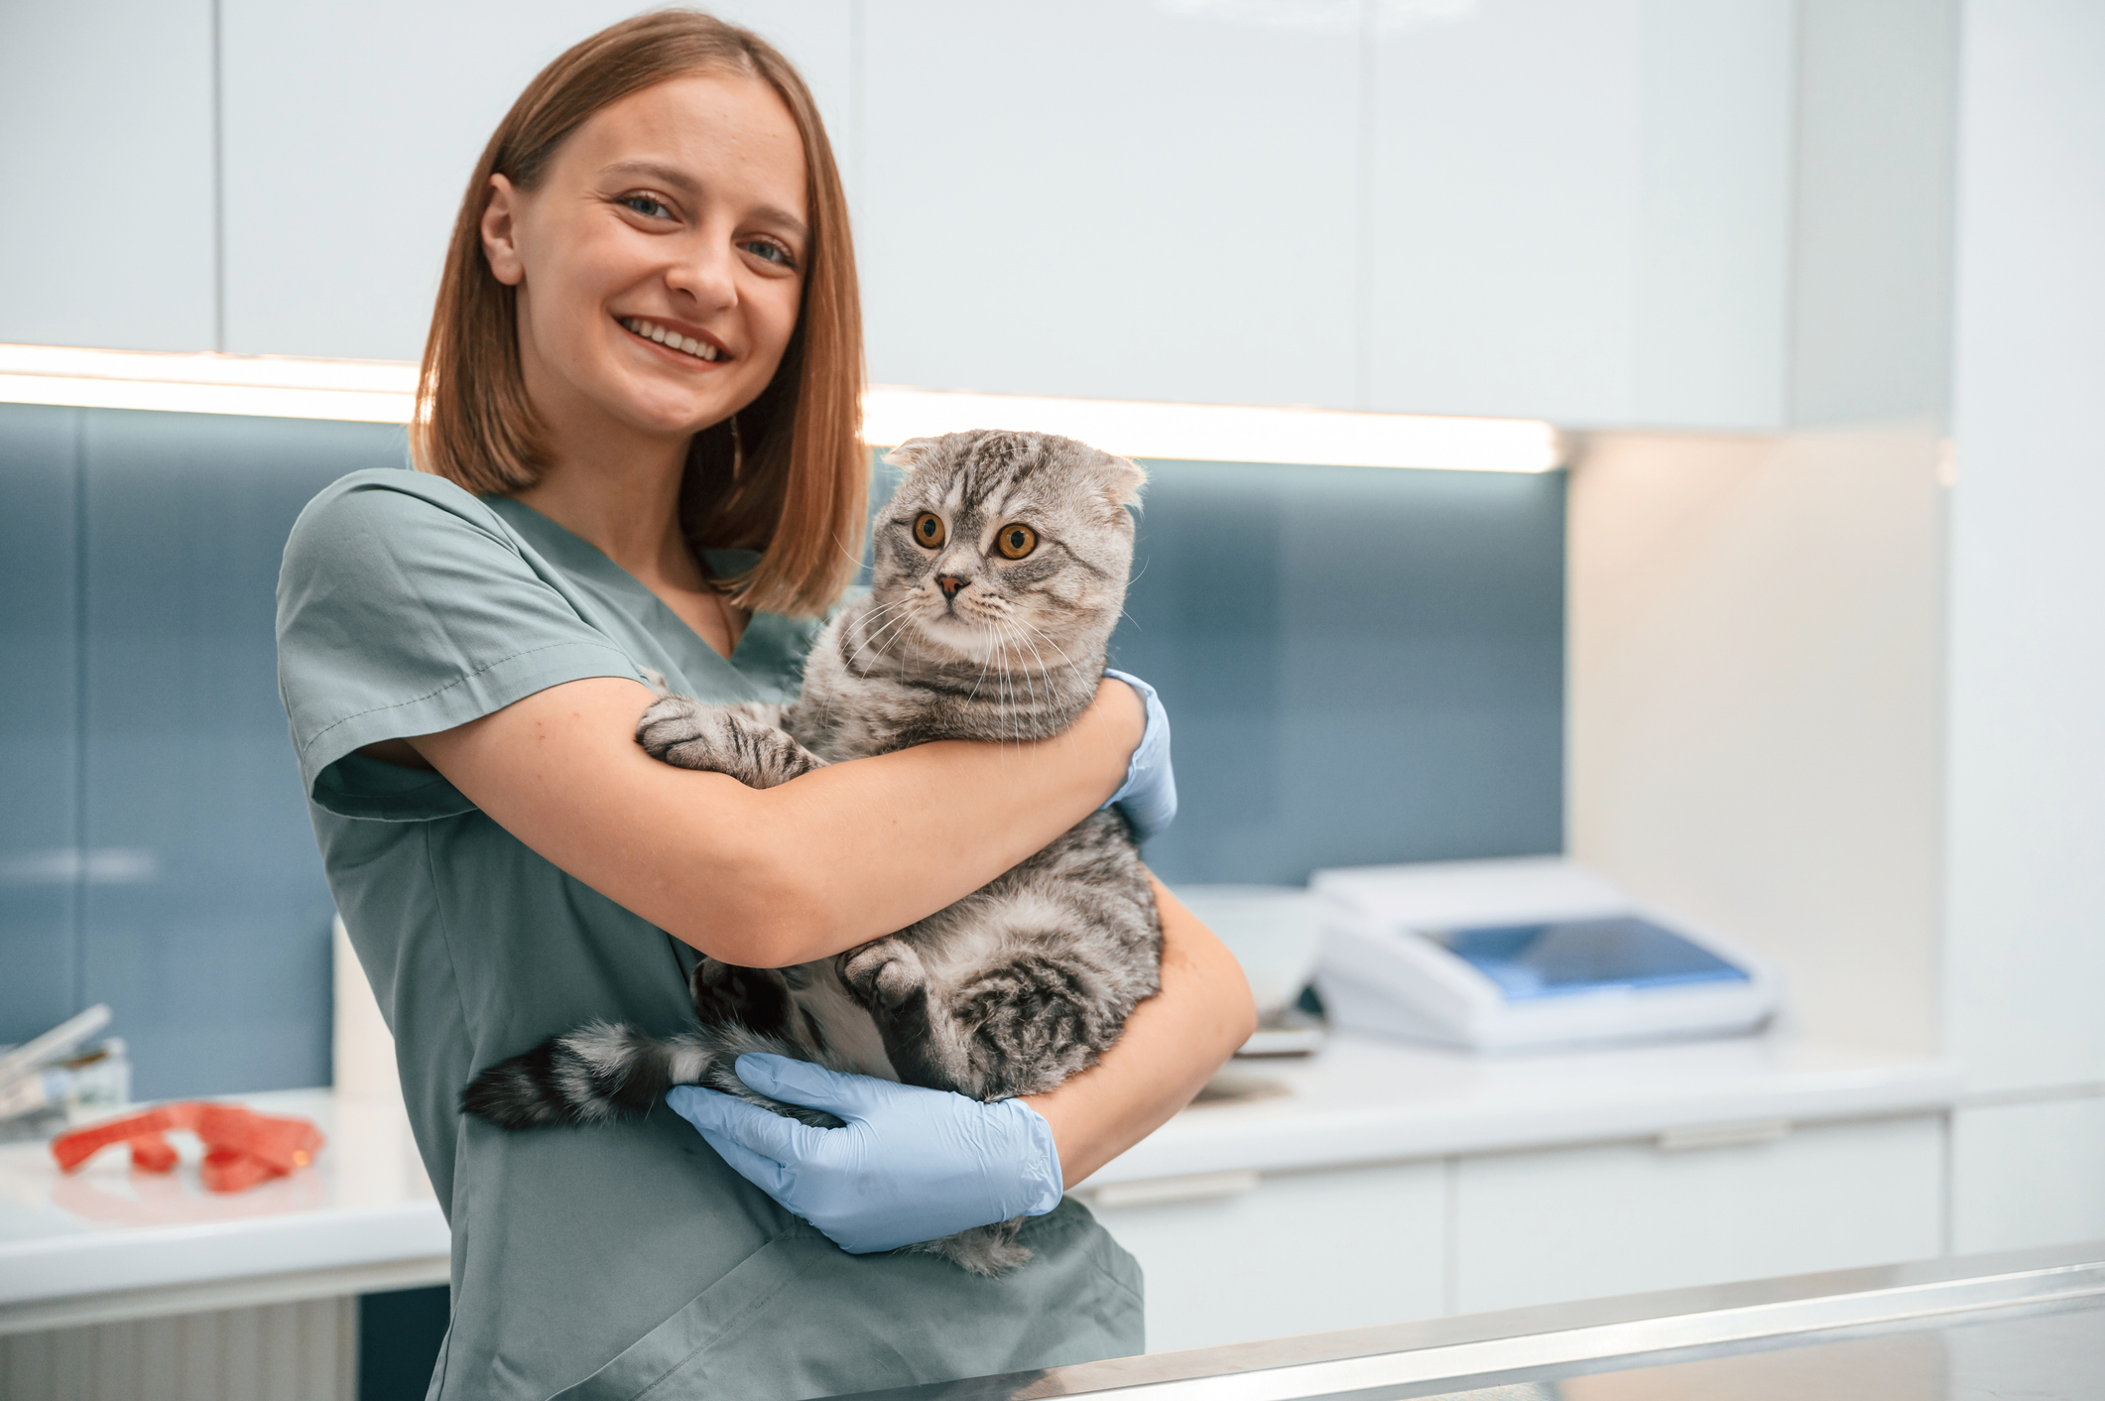
Dr. Chloe – Small Animal Vet Clinic
Chloe runs a busy veterinary clinic in town. She has two nurses, treats cats and dogs, and stores expensive medicines and equipment.
She also stores her customer information on her website system.
Think about…
What could go wrong for Chloe?
What types of insurance might protect his business?
Did you get these? Now you’re thinking like a broker!

Slide 12
Good job!
Possible Risks for Dr. Chloe
Fire, theft, injured staff, cyber attack, customer injuries
Types of Insurance she needs
Public Liability Insurance
Covers you if someone gets hurt or something gets damaged because of your business
Business Interruption Insurance
Helps cover lost income if your business can’t open after damage or disaster.
Business Property Insurance
Covers your shop, gear, or stock if there’s a fire, theft, or storm damage.
Workers’ Compensation
Covers employees if they get hurt or sick while working.
Cyber Insurance
Protects you if hackers steal data or shut down your system.
Pet Business Insurance
For groomers, walkers, or vets - covers accidents, injuries, or pet escapes.
Notes:
Possible risks:
Fire, theft, injured staff, cyber attack, customer injuries
Likely cover: Business property, workers’ comp, business interruption, public liability, cyber insurance, pet business insurance

Slide 13
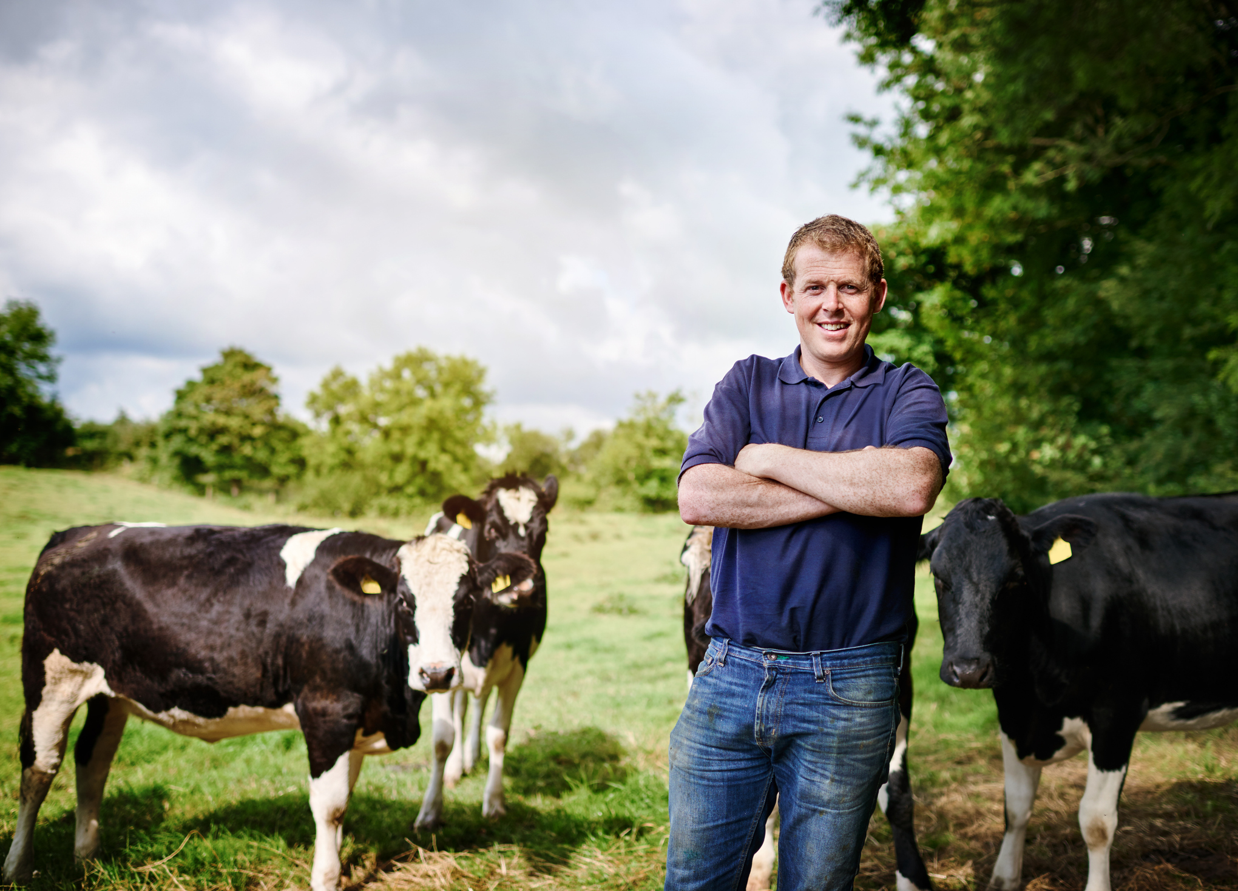
Ben – Dairy Farm Owner
Ben runs a family-owned dairy farm in regional NSW.
He employs five staff, owns tractors and milking equipment, and has over 200 cows.
His farm also sells milk to local processors and sometimes hosts school tours.
Think about…
What could go wrong for Ben?
What types of insurance might protect his business?

Slide 14
Great work!
Possible Risks for Ben
Animal illness or injury, storms, floods or bushfires, worker injuries, visitor accidents, loss of income
Types of Insurance she needs
Farm Insurance
Protects crops, livestock, and machinery from damage or loss
Business Interruption Insurance
Helps cover lost income if your business can’t open after damage or disaster.
Business Property Insurance
Covers your shop, gear, or stock if there’s a fire, theft, or storm damage.
Workers’ Compensation
Covers employees if they get hurt or sick while working.
Public Liability Insurance
Covers you if someone gets hurt or something gets damaged because of your business
Income Protection
Covers a business owner’s or key worker’s income if they can’t work due to illness or injury
Notes:
Possible risks: Animal illness or injury. Storms, floods, or bushfires, Worker injuries, Visitor accidents (during farm tours), Loss of income if production stops
Likely insurance cover:
Farm Insurance , Business Interruption Insurance ,Business Property Insurance, Workers’ Compensation, Public Liability Insurance, Income Protection

Slide 15

Maya – Renewable Energy Business
Maya helps run a renewable energy business that builds and maintains solar farms and wind turbines across regional Australia. Her company has 60 staff, including electricians, technicians, engineers and field workers.
They supply clean energy to businesses, councils and communities.
Think about…
What could go wrong for Ben?
What types of insurance might protect his business?

Slide 16
Good job!
Possible Risks for Maya
Weather impacts, equipment damage, injuries to workers, cyber attacks
Types of Insurance they need
Public Liability Insurance
Covers you if someone gets hurt or something gets damaged because of your business
Business Interruption Insurance
Helps cover lost income if your business can’t open after damage or disaster.
Business Property Insurance
Covers your shop, gear, or stock if there’s a fire, theft, or storm damage.
Workers’ Compensation
Covers employees if they get hurt or sick while working.
Cyber Insurance
Protects you if hackers steal data or shut down your system.
Notes:
Possible risks:Weather impacts, equipment damage, injuries to workers, cyber attacks
Likely insurance cover:
Public liability, business interruption, business property insurance, workers compensation, cyber insurance

Slide 17
Do you like art, animals, cars or even movies?
Many insurance brokers choose to specialise in a specific industry or type of risk like these, allowing them to become trusted experts in that area.
That’s where following your passion comes in!
Notes:
The previous activity will have showcased the range of businesses and types of cover you work with as a broker – let students know that if they have a niche interest they can still become a broker

Slide 18
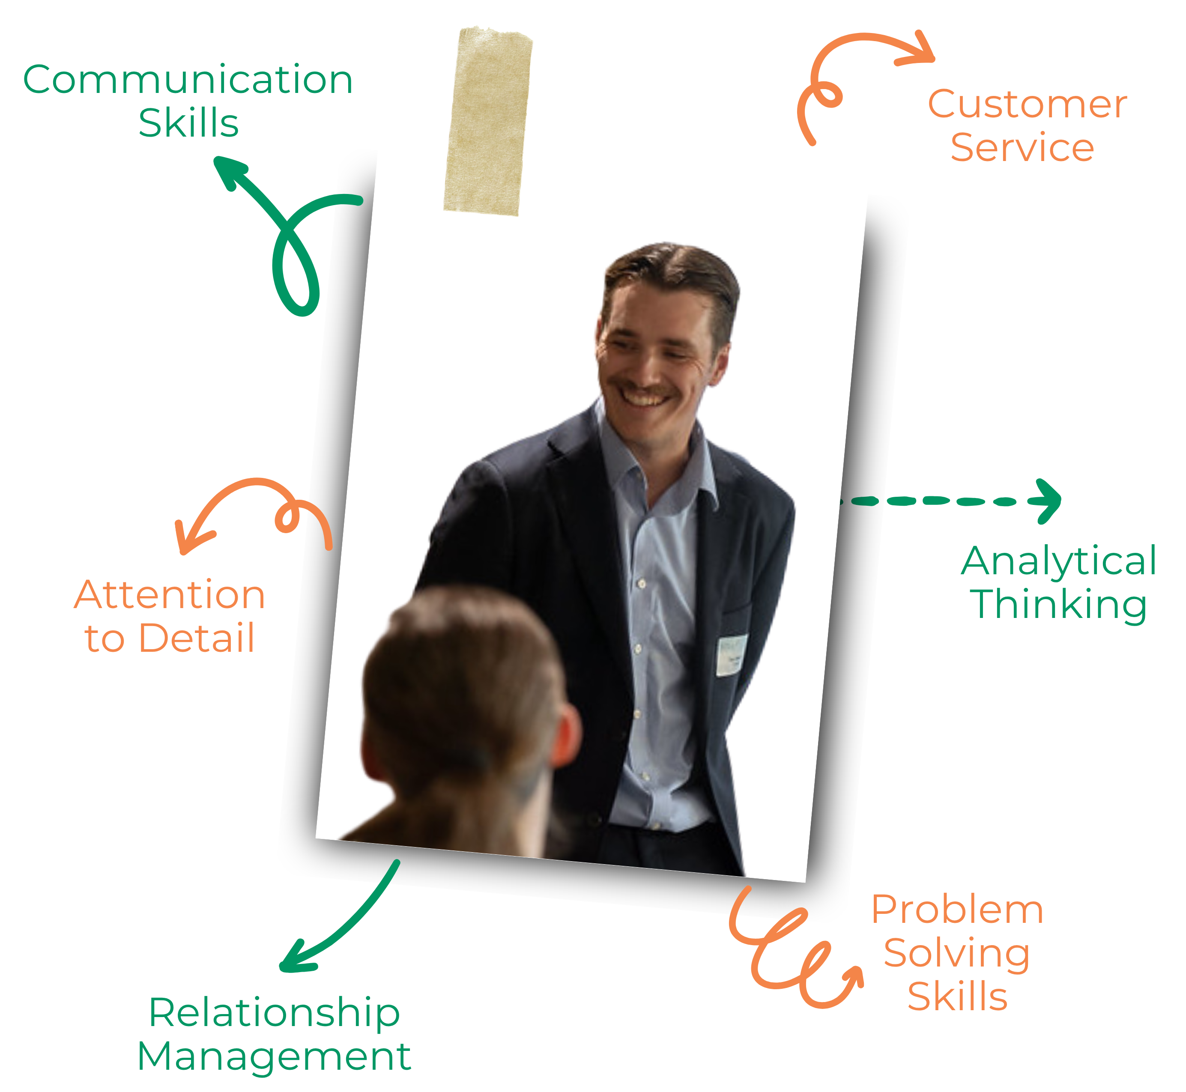
Skills every Broker needs
Communication Skills - Explaining complex policies and listening to client
Customer Service - Providing helpful guidance, support, and a positive experience for every client
Attention to Detail - Carefully reviewing information, documents, and policies to avoid errors
Analytical Thinking - Interpreting data, market trends, and client needs
Relationship Management - Building long-term relationships and support
Problem Solving Skills - Assessing client risks and understanding policies
Notes:
Discuss various pathways

Slide 19
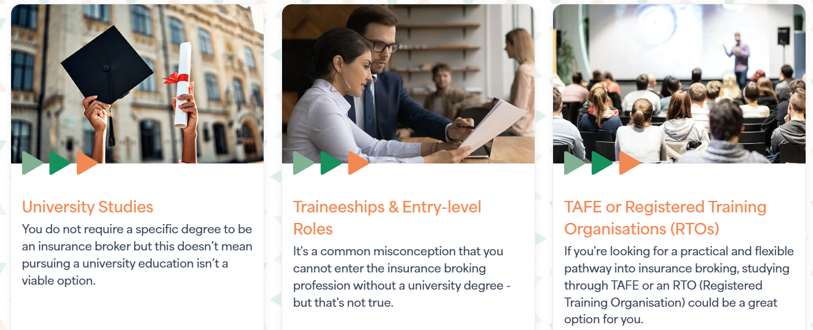
How to become a Broker
Notes:
Discuss various pathways

Slide 20

Find out More
Visit the ‘Insure Your Future’ website and:
  Learn more about becoming a broker
  Hear from real brokers
  Find your pathway
  Explore opportunities near you

Slide 21

